Slide 1
INTERNATIONALIZATION
@
TSHWANE UNIVERSITY OF TECHNOLOGY
(TUT)
Presented by:
Lawrence Maake at International Staff Week Wroclaw University of Technology , Poland 11-15 May 2015
Institutional Repository Librarian/ Open Access Administrator

Slide 2
BACKGROUND
TUT International Office was established on 01 January 2004.
Responsibility – Office of the Registrar
OR has as its core business to facilitate and promote all facets of internationalization at TUT.
OR aims to engage with reputable institutions and organisations of international standing and whose bona fides have been clearly established.
OR seeks to increase TUT international profile and provide opportunities for academic networking

Slide 3
Role of OR within the broader TUT context
Ensure that internationalization activities contribute to vision, mission and values to support the core functions of teaching, learning and research at TUT
Seeking, supporting and facilitating opportunities for TUT staff and students to experience academic life at international partner universities through mobility exchanges
Generating opportunities for improving its position as an African University of Technology
Ensure that internationalization activities are aimed at enhancing TUT academic and research capacity and global competitiveness.

Slide 4
OTHER ROLES (GENERAL)
Organise orientation days for new international students
Organise events for international students
Coordinate exchange programs with countries across the world
Promote the University by visiting other countries
Support international students throughout their period of study

Slide 5
Internationalization activities at TUT
Recruitment of International Staff and Students
Staff Exchange Programs
Research and Development
Student Exchange Programs
Sport Activities
Cultural Activities

Slide 6
PARTNERSHIPS AND COLLABORATIONS
TUT partnered and collaborated with a number of institutions and organizations internationally
Good relationship with KU in Leuven resulted in
    Establishment of a water purification plant in Tshanda (in Limpopo Province)
    Installation of commercial plastic filtration membrane

Slide 7
…/2 PARTNERSHIPS AND COLLABORATIONS
• Joint research project with East Anglia University resulted in
  “On-site water management report based on collaborative research between UK, Ghana, Sierra Leon and Tanzania

Slide 8
…/3 PARTNERSHIPS AND COLLABORATIONS
Otto Bock (Germany) and Ossur (Iceland) Prosthetic organizations together with our Department of Sport and Rehabilitation and Dental works directly with patients in the specialised field of physical rehabilitation by assessing, measuring, designing, manufacturing and fitting orthoses and prostheses to assist with the rehabilitation of physically impaired patients.
This Department is headed by one of our international professors

Slide 9
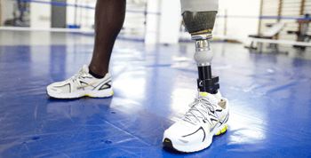

Slide 10
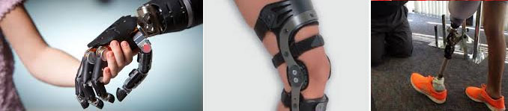

Slide 11
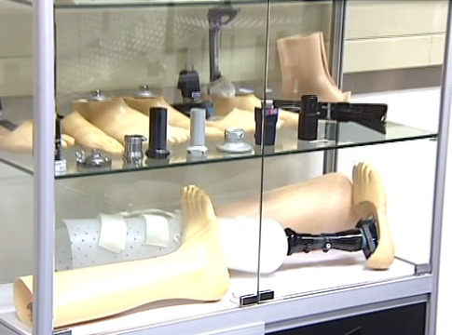

Slide 12
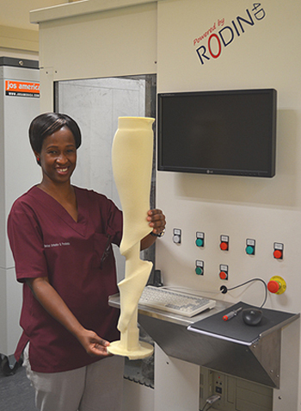
Medical Orthotics and Prosthetics lecturer, Pearl Boshof demonstrating the RODIN 4D computer aided design and manufacturing equipment in the newly refurbished laboratory.

Slide 13
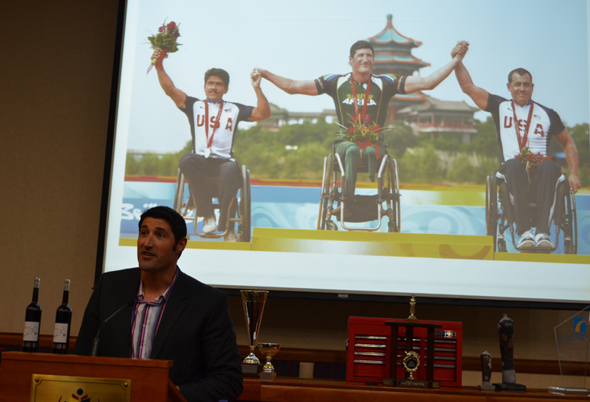
Multiple Paralympian medal winner and 9 times Boston Marathon wheelchair champion, Ernst Van Dyk delivering the keynote address
at the opening of the Medical Orthotics and Prosthetics laboratories at TUT.

Slide 14
…/4 PARTNERSHIPS AND COLLABORATIONS
TUT – participates in a number of exchange programs for
both staff and students:
  Students from Windsheim University (Netherlands) accompanied by their lecturer experienced the South African education system first-hand as part of an exchange program with TUT’s Department of Educational Studies (2014)
  EU SATURN – The European Scholarship for South Africans
  Belgium exchange programme; etc.

Slide 15
…/5 PARTNERSHIPS AND COLLABORATIONS
TUT signed a number of MOUs and MOAs benefiting students with bursaries, internships and experiential learning; e.g.
French South African Institute of Technology
Hebei University of Economic and Business in China, a move aimed at paving the way for development in academic teaching and research.

Slide 16
…/6 PARTNERSHIPS AND COLLABORATIONS
The Herbert Haag Sport Information Centre was established in 2008 after Prof. Herbert C Haag, M.S. Professor Emeritus for Sport Science at the University Sport and Sport Sciences of the University of Kiel, Germany, donated his private collection to TUT
The purpose of the Centre is to provide sports information and to act as a gateway to sport-related information services and resources supporting the needs of the sports community and academic institutions on the African Continent
TUT LIS is working towards digitising this collection and upload into the TUT Digital Open Repository for global access.

Slide 17
RESEARCH CHAIRS
Seven of our 9 Research Chairs are internationals specializing in
the following areas:
Agrochemurgy and Plant Symbioses
Water Quality and Wastewater Management
Innovation Studies
Acid Mine Drainage
Enabled Environment and Assistive Living
Electrical Engineering
Organic Chemistry

Slide 18
ACADEMIC STAFF AND STUDENT PROFILE
TUT employed 193 international academic staff between 2013 – 2015
2500 international students enrolled - 2015

Slide 19
ACADEMIC STAFF PROFILE - 2015
Staff Member | Quantity
Professors | 26
Heads of Departments | 3
Senior Lecturers | 21
Lecturers | 43
Junior Lecturers | 4
Part-Time Lecturers | 91
Examiners/Moderators | 2
Postgraduate Teaching Assistants | 2

Slide 20
CONCLUSION
Internationalization Strategy - Regularising internationalization activities

Slide 21
Thank you
Lawrence Maake
maakelm@tut.ac.za
LIBRARY AND INFORMATION SERVICES
+27 12 382 4604
+27 786965541

